Slide 1
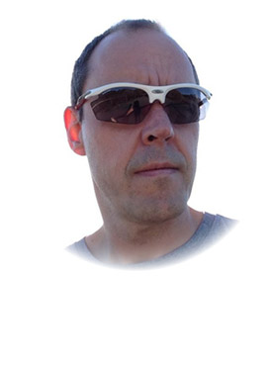

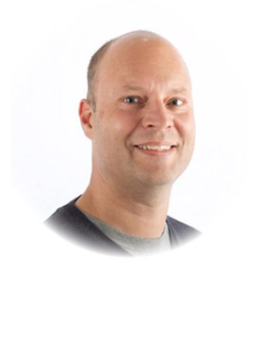
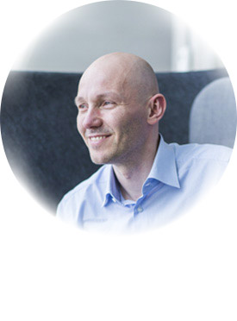
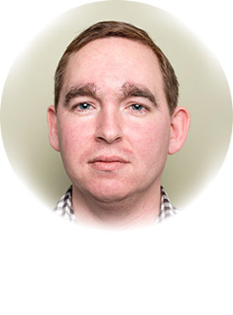
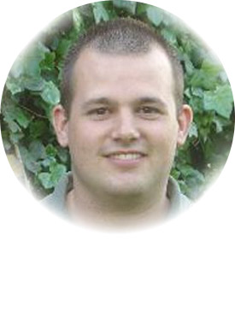
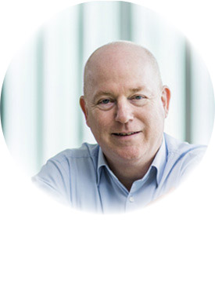
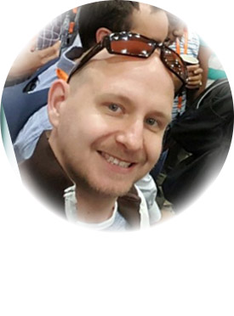
Global Organizers
Martin Abbott
Glenn Colpaert
Steef-Jan Wiggers
Tomasso Groenendijk
Eldert Grootenboer
Sven Van den brande
Gijs in ‘t Veld
Rob Fox

Slide 2
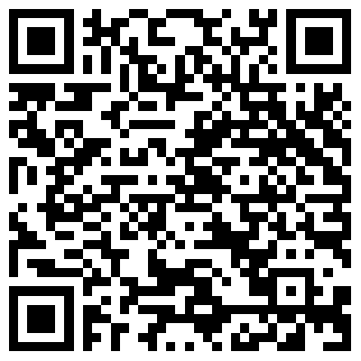
Labs
https://github.com/GlobalIntegrationBootcamp/GlobalIntegrationBootcamp/tree/master/2018/Labs

Slide 3
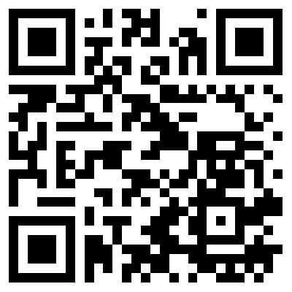
BizTalk Server Open Source Community
https://github.com/BizTalkCommunity

Slide 4
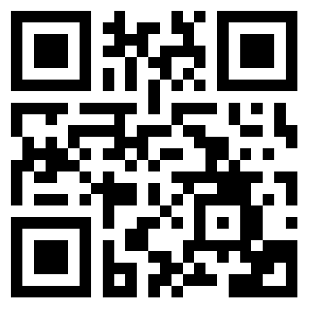
Please fill out the survey!
http://bit.ly/2ptjRdL

